Slide 1
Finding the Subnet, Broadcast and Useable Host Ranges
Lecture 10
IPV6
CIDR Route Aggregation

Slide 2
Introduction
IP Version 6
  Is the successor to the currently used IPv4
  Specification completed in 1994
  Makes improvements to IPv4 (no revolutionary changes)
  One feature of IPv6 is a significant increase in size of the IP address to 128 bits (16 bytes)

Slide 3
IPv6 vs. IPv4: Address Comparison
IPv4 has a maximum of
2³² ≈ 4 billion addresses
IPv6 has a maximum of
2¹²⁸ = (2³²)⁴ ≈ 4 billion x 4 billion x 4 billion x 4 billion addresses

Slide 4
CIDR-Route Aggregation
Consider the extremely large number of independent network addresses that exist on the Internet. Now imagine your router has to keep a record of every one of those addresses in it's routing table. Here we have a dilemma.
If your router does not keep a record of all possible addresses, then your packets may be dropped due to destination unknown problems.
If it does keep a record of all the addresses then it's routing table will be HUGE.

Slide 5
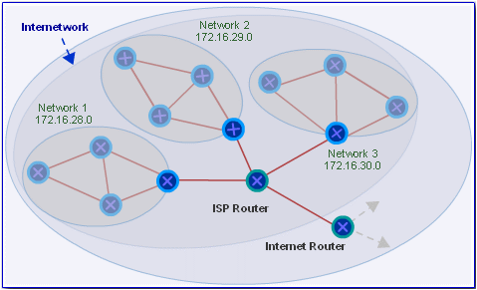
CIDR-Route Aggregation
One obvious solution is to store addresses based on classes. Let's consider the problem from the point of view of an ISP. An ISP may have the responsibility for allocating a vast range of network addresses. Suppose our particular ISP is responsible for 3 different Class B addresses from 172.16.28.0 to 172.16.30.0.

Slide 6
Example -Cont.
Would an external Internet router need to store the 3 different network addresses in it's routing table?

Slide 7
Example 1-Cont.
Rather than store each separate network addresses, a more efficient way would be to store one single supernet network address that represents the three Class B network addresses. An Internet router could just keep a single supernet entry in it's routing table and route any packets for the supernet to the ISP's router. The ISP's router could deal with the matter of getting the packet to the appropriate network in the supernet.
Combining network addresses together is called route aggregation and the combined network is called a supernet. You can imagine supernets as the opposite of subnets.

Slide 8
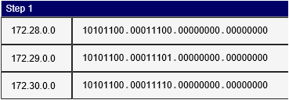
Route Aggregation
The three separate network addresses of 172.28.0.0/16, and 172.29.0.0/16 and 172.30.0.0/16 can be aggregated into the single super network address of 172.28.0.0/14.
Let's see how I calculated the supernet address.
Step 1: Convert each address into binary

Slide 9
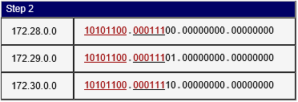
Cont.
Step 2: Determine which bits of the address are the same and which bits are variable.

Slide 10
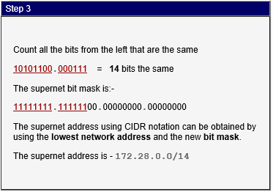
Cont.
Step 3: Work out the network prefix.
So now, any Internet router can store the single supernet address of 172.28.0.0/14 in it's routing table instead of the three separate network addresses, thus reducing the number of routing table entries required.

Slide 11
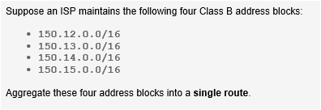
Class Work

Slide 12
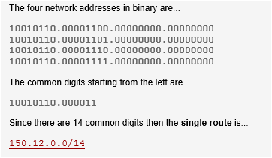
Solution

Slide 13
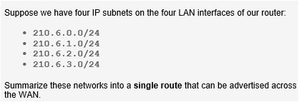
Class Work 2

Slide 14
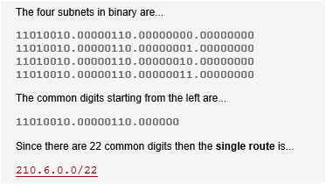
Solution

Slide 15

Class Work 3

Slide 16
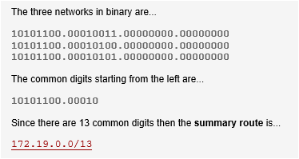
Solution

Slide 17

Class work 4

Slide 18
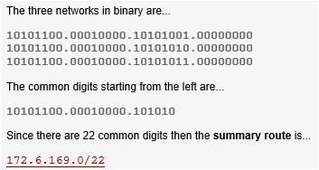
Solution

Slide 19

Class work 5

Slide 20
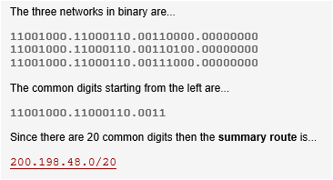
Solution

